Slide 1
Digital Image Processing Project
By:
Manjunath N.(1MS17IS062)
Mayur S. H.(1MS17ISo63)
Mahesh G.(1MS17IS060)

Slide 2
Problem Statement
Brain tumor segmentation and Classification of tumors in an efficient and precise way using watershed algorithm based DAAP features.

Slide 3
Objective Outcome
Brain tumor detection is a tedious task in the field of medical imaging. Here in this paper proposes the state of art tumor detection techniques using the Watershed Dynamic Angle Projection - Convolution Neural Network (WDAPP-CNN). The watershed algorithm accurately segments the tumor region. The dynamic angle projection pattern extracts the textured features of the brain and the convolutional neural network classifies the tumor and non-tumor regions of the MRI brain image. It can also be extended to identify the other types of tumors such as a pancreatic tumor, adenomas, fibromas.

Slide 4
Literature Survey
Tumor Detection and Classification of MRI Brain Image using Different Wavelet Transforms and Support Vector Machines.
Capsule Networks For Brain Tumor Classification Based on MRI Images and Coarse Tumor Boundaries
Tumor Detection in the Brain using Faster R-CNN
Brain Tumor Classification and Segmentation in MRI Images using PNN
The Multimodal Brain Tumor Image Segmentation Benchmark (BRATS)

Slide 5
Dataset description and links
The abnormality of the brain image is detected and testing is achieved through the BRATS dataset in an efficient way.
The experimental results are implemented through the BRATS database which achieves better dice score efficiency 93.5% and sensitivity 94.2%.
Link : https://figshare.com/articles/brain_tumor_dataset/1512427

Slide 6
Software and Hardware details
Software requirements are MATLAB.
Hardware requirements are MRI machine to generate the images, Personal Computer with the necessary processing capabilities to work with MATLAB.

Slide 7
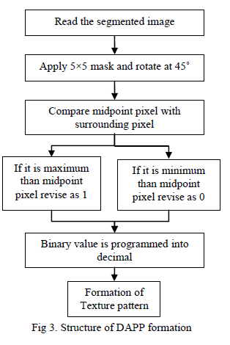
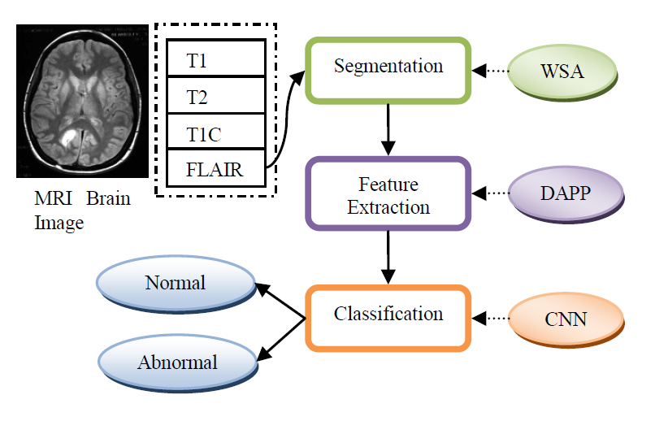
System Design

Slide 8
Algorithm
Input: MRI Brain image
Output: Display the tumor region
1. Reads MRI brain image
2. Choose the flair modality for segmentation
3. Apply median filter and morphological operation to
get preprocessed image
4. Segment the tumor sections from preprocessed
image using basic Global thresholding algorithim and to obtain the threshold image using step 1.
5. Segments tumor sections from the preprocessed
image using the Water Shed Algorithm using step 4.
6. Compute Dynamic Angle Projection Pattern
descriptor for texture feature extraction.
7. Display the tumor region.

Slide 9
Drawbacks of the paper implemented
The algorithm used is highly sensitive to local minima, since at each minima watershead is created.
If we have an image with noise this will influence the segmentation
The algorithm has a higher time complexity than the other papers

Slide 10
Future Enhancement
In future work, for classification and segmentation of brain tumor, some other different features can be compared to get more accuracy.
It can also be extended to identify the other types of tumors such as a pancreatic tumor, adenomas, fibromas.

Slide 11
Conclusion
The proposed brain tumor segmentation is implemented through the Water Shed Algorithm (WSA), Dynamic Angle Projection Pattern features . The importance of watershed segmentation algorithm is which extracts the tumor regions in an accurate manner for proficient DAPP feature extraction. The DAPP extracts the texture features from the segmented tumor regions and histogram features are obtained. The segmentation and classification of MRI brain image are necessary for the proficient diagnosis of brain tumor. The experimental results are implemented through the BRATS database which achieves better dice score efficiency 85%. We can use this application in real time system which is very helpful in the field of medicine.

Slide 12
Bibliography
R. Pourreza, Y. Zhuge, H. Ning, and R. Miller, “Brain Tumor Segmentation in MRI Scan Using Deeply-Supervised Neural Networks,” brainless, Lect. Notes Comput. Sci., vol. 10670, pp. 320–331, 2018.
S. M. K. Hasan and M. Ahmad, “Two-Step Verification of Brain Tumor Segmentation using Watershed-Matching Algorithm,” Brain Informatics, vol. 5, 2018.
Y. Chen, H. Jiang, C. Li, X. Jia, and P. Ghamisi, “Deep Feature Extraction and Classification of Hyperspectral Images Based on Convolutional Neural Networks,” IEEE Trans. Geosci. Remote Sens., vol. 54, no. 10, pp. 6232–6251, 2016.
E. Ilunga–Mbuyamba, J. G. Avina–Cervantes, J. Cepeda–Negrete, M. A. Ibarra–Manzano, and C. Chalopin, “Automatic Selection of Localized Region-Based Active Contour Models using Image Content Analysis Applied to Brain Tumor Segmentation,” Comput. Biol. Med., vol. 91, pp. 69–79, 2017.
S. Bauer, R. Wiest, L. P. Nolte, and M. Reyes, “A Survey of MRIBased Medical Image Analysis for Brain Tumor Studies,” Phys. Med. Biol., vol. 58, no. 13, pp. R97–R129, 2013.

